Slide 1
FIT1047 Week 5 & 6 Forum
Introduction to Computer Systems, Networks and Security

Slide 2
Learning Outcomes
At the end of this workshop, you will be able to:
1. Explain how I/O devices communicate with the CPU
2. Understand the steps required to "boot" a computer
3. Explain the difference between programs and processes
4. Understand how a single CPU can appear to execute multiple processes at once
5. Explain simple process scheduling algorithms
6. Understand the importance of virtual memory

Slide 3
Memory-mapped I/O vs Instruction-based I/O
State the differences between memory-mapped I/O and instruction-based I/O?

Slide 4
Programmed I/O vs Interrupt-Based I/O
State the differences between programmed I/O and interrupt-based I/O?

Slide 5
DMA
Briefly discuss the working principle of DMA.

Slide 6
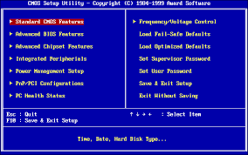
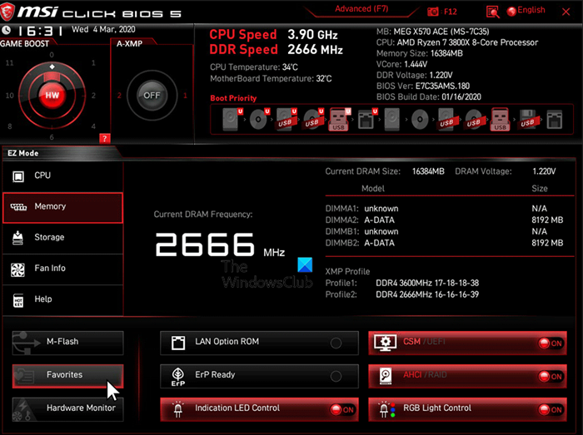
UEFI vs BIOS
Compare and contrast UEFI and BIOS.

Slide 7
Operating System (OS)
What Does OS Do?

Slide 8
OS Kernel
Explain how kernel works?

Slide 9
Processes
Explain the state of the processes and show how process switching can be done.

Slide 10
Timesharing
Briefly explain how timesharing can be used to virtualize the CPU.

Slide 11
Virtual Memory and Paging
Briefly explain how virtual memory and paging work.

Slide 12


